Slide 1
Cognitive Search Lab – Knowledge Mining on Business Documents
Rodrigo Souza – rosouz@microsoft.com
Applied Data Scientist
LearnAI Team / Cloud & AI

Slide 2
LearnAI Team http://aka.ms/LearnAI-Portal http://aka.ms/LearnAI-GitHub http://aka.ms/LearnAI-Links This Training http://aka.ms/LearnAI-Airlift

Slide 3
This Training http://aka.ms/LearnAI-Airlift LearnAI Airlift = CSB (50%) + KMB (50%)

Slide 4
Training Goals – What Will You Learn
Cognitive Services
Computer Vision
Custom Vision
LUIS
Content Moderator
Text and Knowledge APIs
Bing Search API
Azure Search / Cognitive Search
Bots
Azure Functions
Poll

Slide 5
Training Goals – How Will You Learn
Presentations
Hands-On Labs to Build E2E Applications
Intelligent Search
Cognitive Search
Bot Interfaces for both

Slide 6
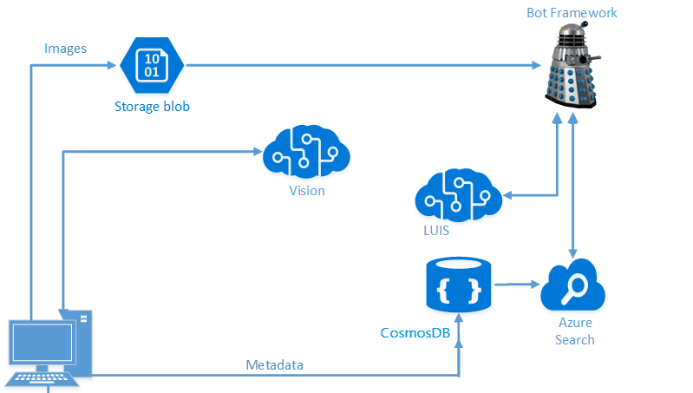
Architecture – Intelligent Search

Slide 7
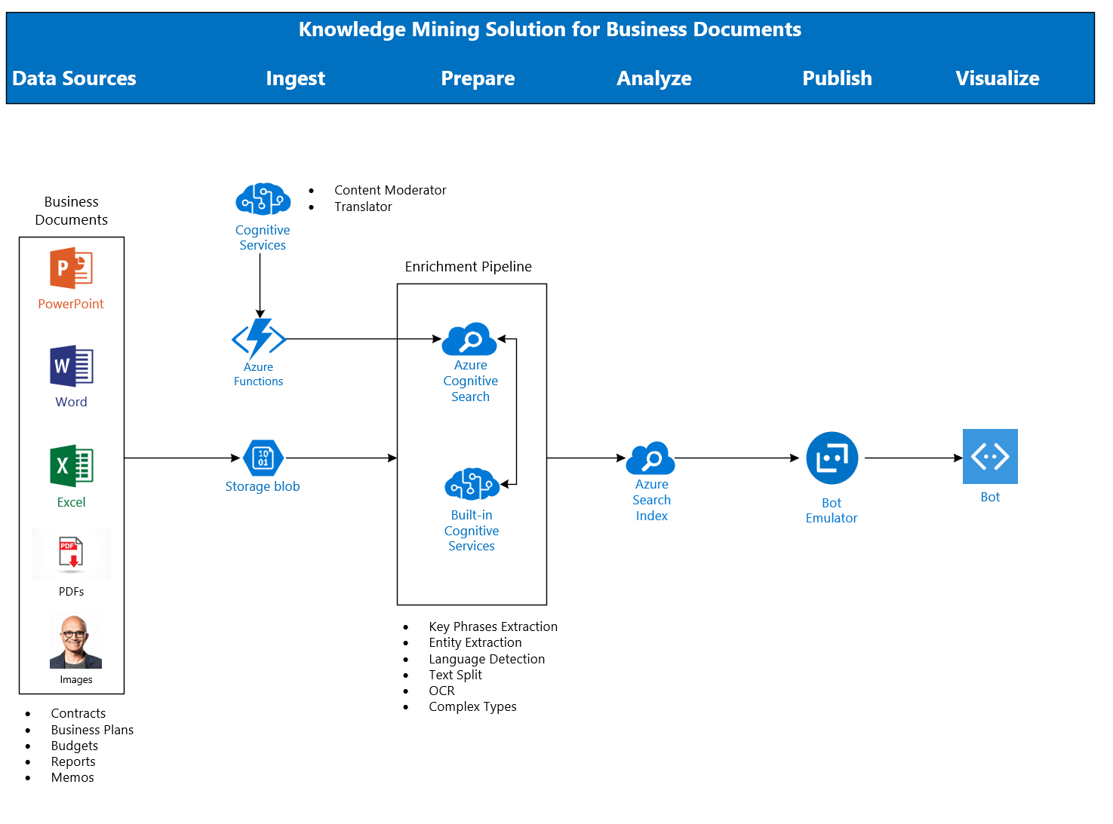
Architecture - Cognitive Search

Slide 8
Housekeeping
Breaks
Lunch
Restrooms
Wi-Fi
Audience
Partners
Microsoft
Office Hours
Survey

Slide 9
Spektra Environment
Azure Account
DSVM
Deployed Services: storage account, CosmosDB, Computer Vision API
Azure Search should be created in the same region of the DSVM

Slide 10
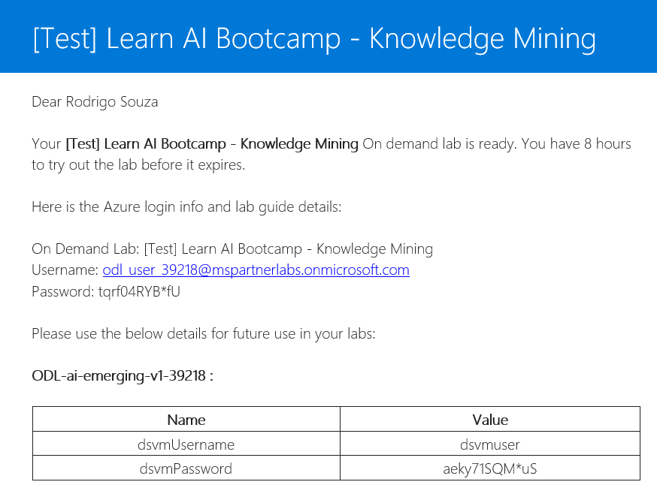
Spektra Environment
http://bit.ly/2HrX8e6
Case Sensitive!!
Confirmation email from noreply@cloudlabs.ai

Slide 11
Breaking News
Container support in Azure Cognitive Services
https://docs.microsoft.com/en-us/azure/cognitive-services/cognitive-services-container-support
Power BI delivers AI power
https://www.zdnet.com/article/power-bi-delivers-ai-power/

Slide 12
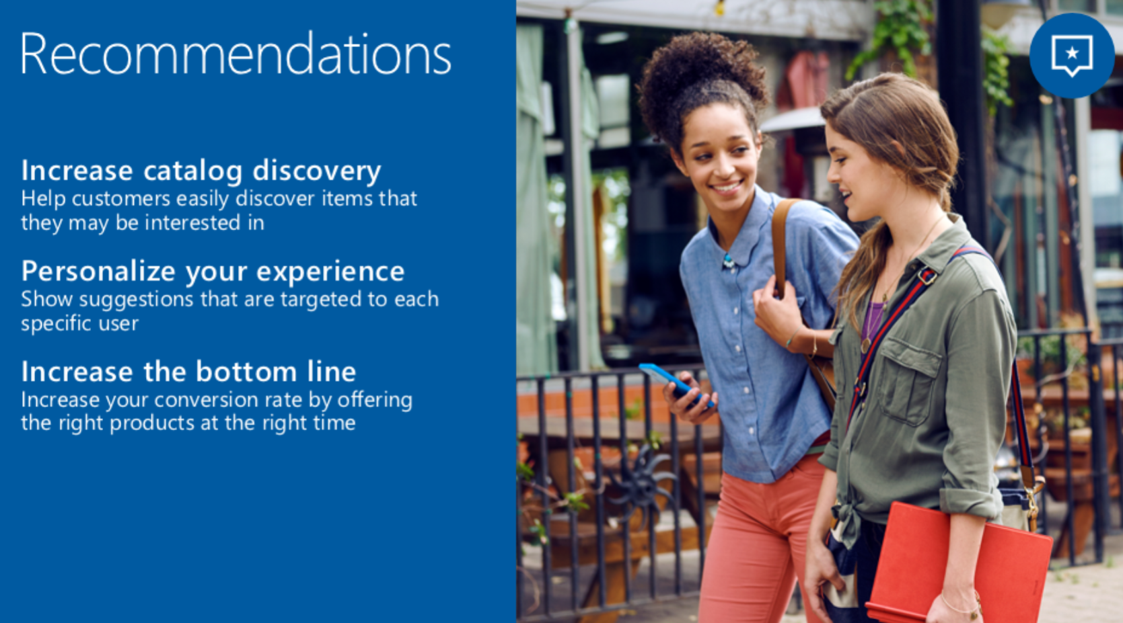
Breaking News

Slide 13
Breaking News
Going to Private Preview – Invitation Only
Personalization and Optimization
Based on Reinforcement Learning
Learns from the real world based on feedback
Don’t need to label the data
Don’t need to train your model
AI suggests and you give a feedback, over and over
Used in Xbox, Bing, Office, Azure, Windows, Skype.
Now available to any developer.

Slide 14
Let’s go! http://aka.ms/LearnAI-Airlift

Slide 15
Backup Slides

Slide 16
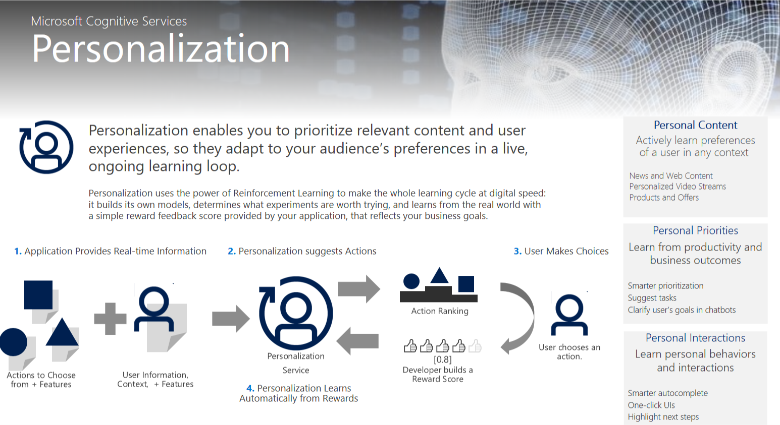
Breaking News

Slide 17
Announcements

Slide 18
Opening Demos
www.azure.com/cognitive
Curl

Slide 19
Custom Vision URLs
https://docs.microsoft.com/en-gb/azure/cognitive-services/custom-vision-service/getting-started-build-a-classifier
http://customvision.ai

